Slide 1
Lost in the Middle How Language Models Use Long Contexts
Karin Brisker

Slide 2
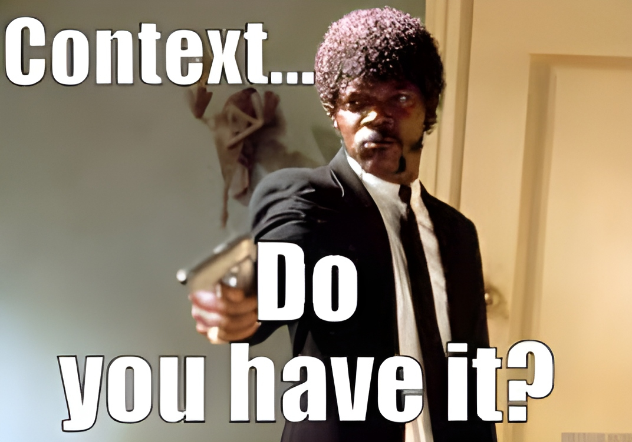
Current Attitude

Slide 3
The Gap
How Well Do These Models Deal with Large Context?

Slide 4
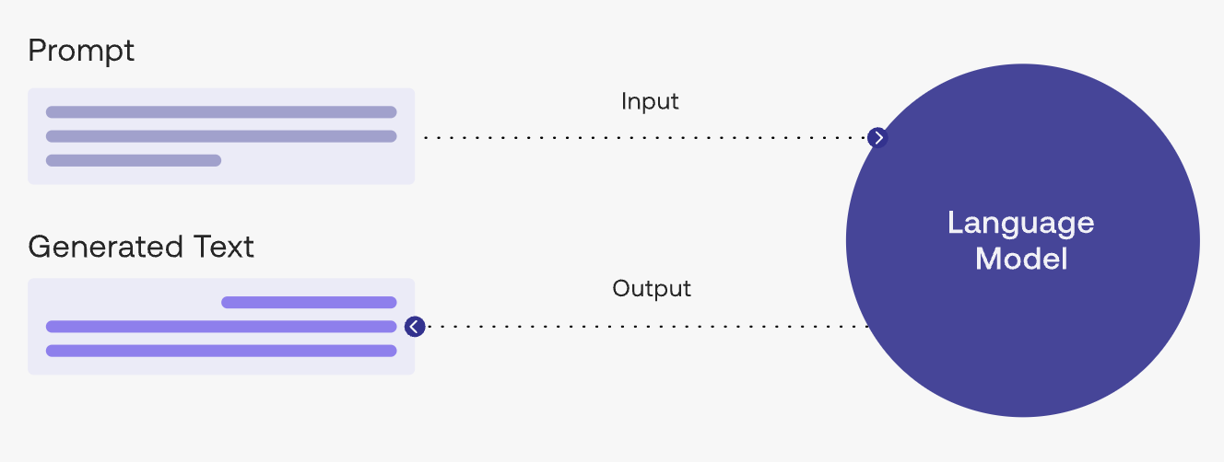
Motivation

Slide 5
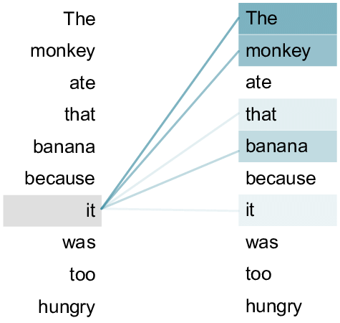
Transformers and Self-Attention

Slide 6
Tested Models
MPT-30b-Instruct
Claude
GPT-3.5-Turbo
LongChat-13B
Closed-Source
Open-Source

Slide 7
Tasks
Multi-Doc Q&A
Key-Value Retrieval

Slide 8
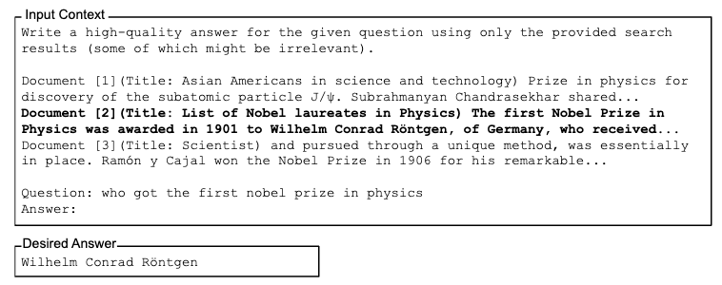
Multi-Document Question Answering

Slide 9
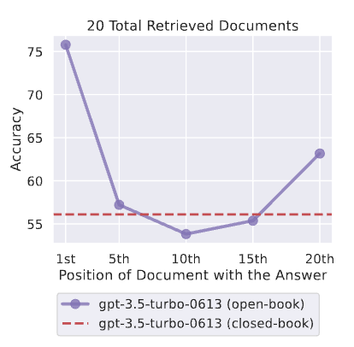
Results

Slide 10
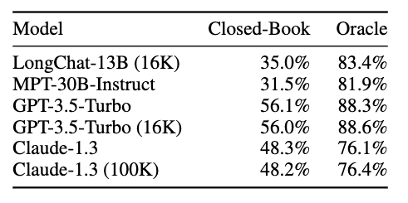
Results

Slide 11
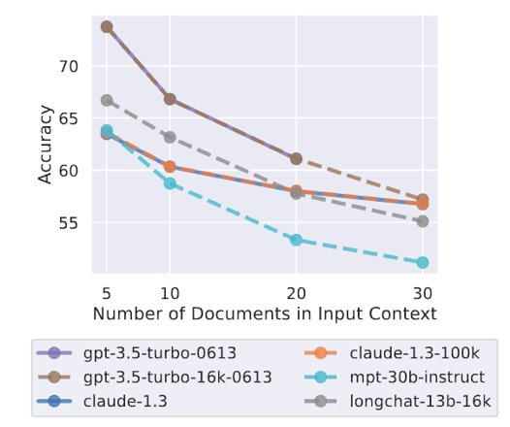
Results

Slide 12
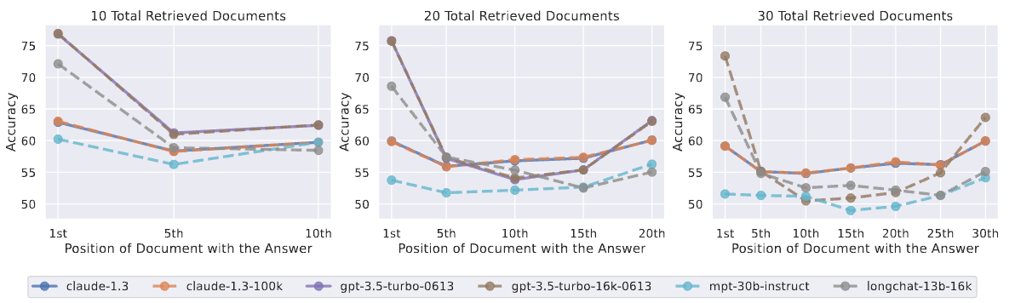
Results

Slide 13
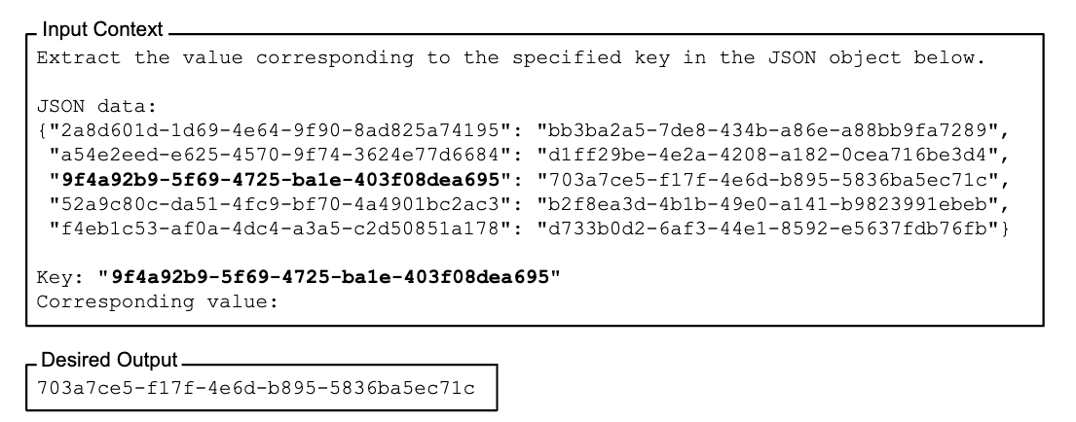
Key-Value Retrieval

Slide 14
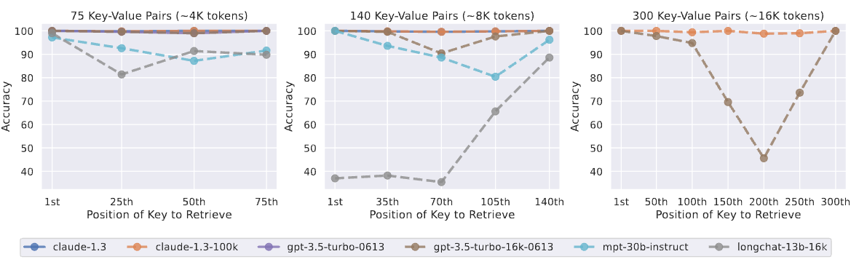
Results

Slide 15
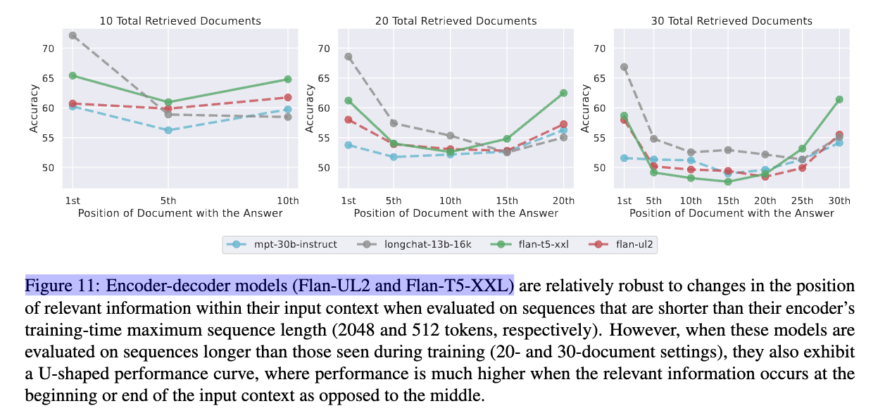
Model Architecture

Slide 16

Complexity-Information Trade-Off

Slide 17

Discussion
Scope and Biases of the Study
Dataset
Models
Relevance Over Redundancy
Effective Problem Solving
Importance of Further Research

Slide 18
Conclusions
Context Length and Performance
Optimal Information Placement
Quality Over Quantity

Slide 19
Thanks for Listening

